Slide 1
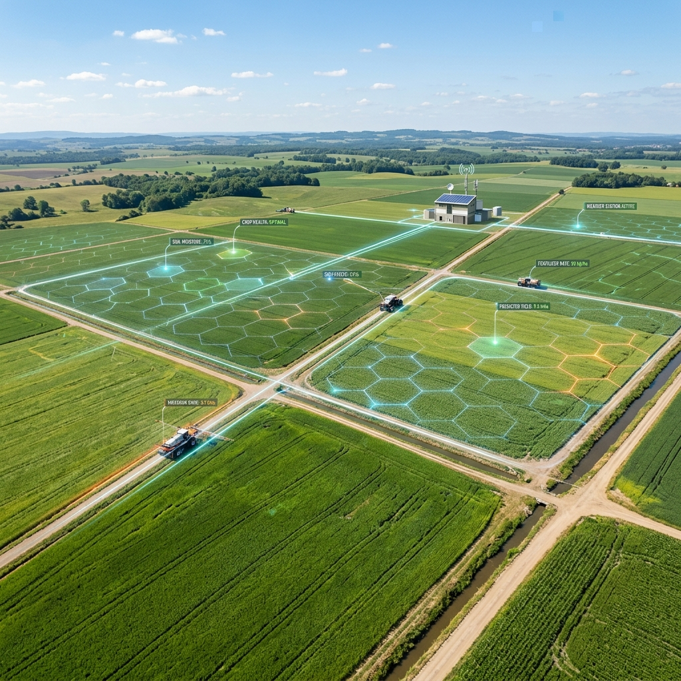
 Farmogram
[Place 'smart_farm_aerial.png' Here]
SMART AGROCONNECT & MANAGEMENT SYSTEM
The Digital Agriculture
Ecosystem.
Presenter: Prajwal Gouda
Register No: U02LT23S0007
Department: Bachelor of Computer Applications
College: Himalaya BCA College
Project Guide: Sameeksha Chopdekar
Academic Year: 2025 - 2026

Slide 2
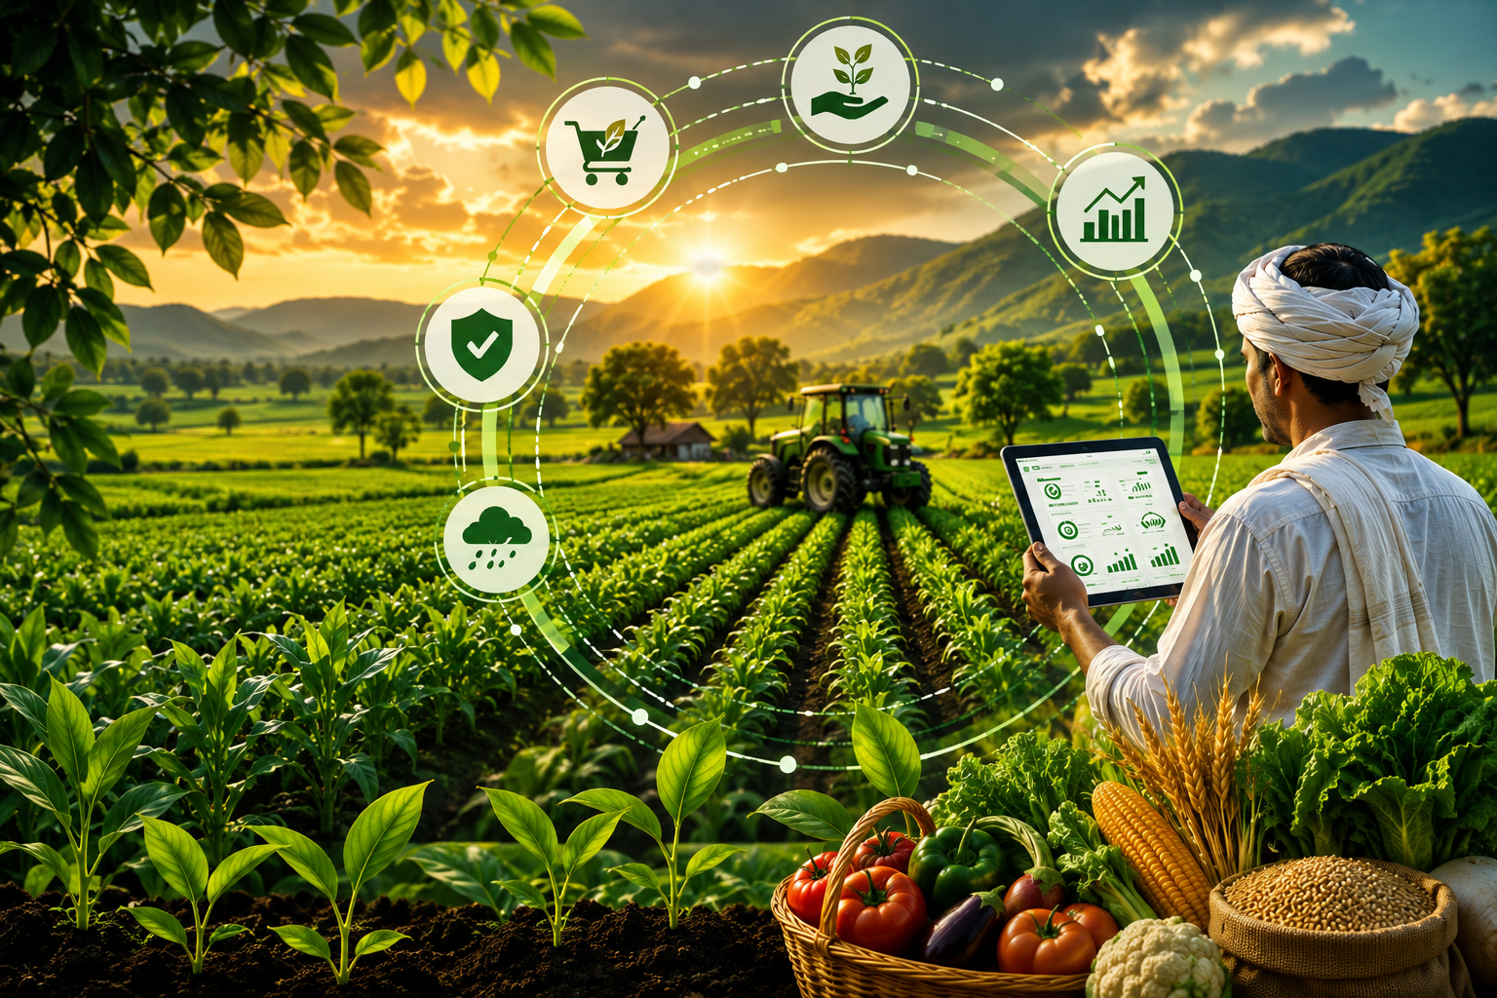
 Introduction
✔ Farmogram is a simple website that helps farmers and buyers connect directly.
✔ Farmers work hard to grow crops, but they still face problems like low profits and depending on middlemen.
✔ This website lets farmers sell their crops directly to shops and final buyers from home.
✔ It removes middle agents, provides advance crop booking, and gives simple farming tools.
[Add image of a farmer using a smartphone here]

Slide 3
 Problem Statement
✔ Farmers sell crops through brokers who take up to 30-40% of their money.
✔ Farmers need money to buy seeds and tools before harvesting, but they only get paid after selling.
✔ Most farming websites are in English, making them hard for rural farmers to use.
✔ Managing farming tasks manually is difficult because farmers depend on memory.
✔ There is a need for a simple digital platform to connect farmers and buyers directly.

The Main Issue
Because there is no direct connection, farmers lose their hard-earned money and buyers do not know if the crops are fresh.

Slide 4
 Project Objectives
We want to make crop selling simple, clear, and direct.

Direct Sales
Create a direct marketplace where farmers keep 100% of the sales money without brokers.

Early Money
Let buyers pay 20% early to help farmers buy seeds and tools.

Direct Chat
Let farmers and buyers chat directly to agree on a fair crop price.

Easy Login
Use local languages and phone numbers so the website is easy to log into.

Task Helper
Help farmers check their daily farming calendar easily without using paper.

Slide 5
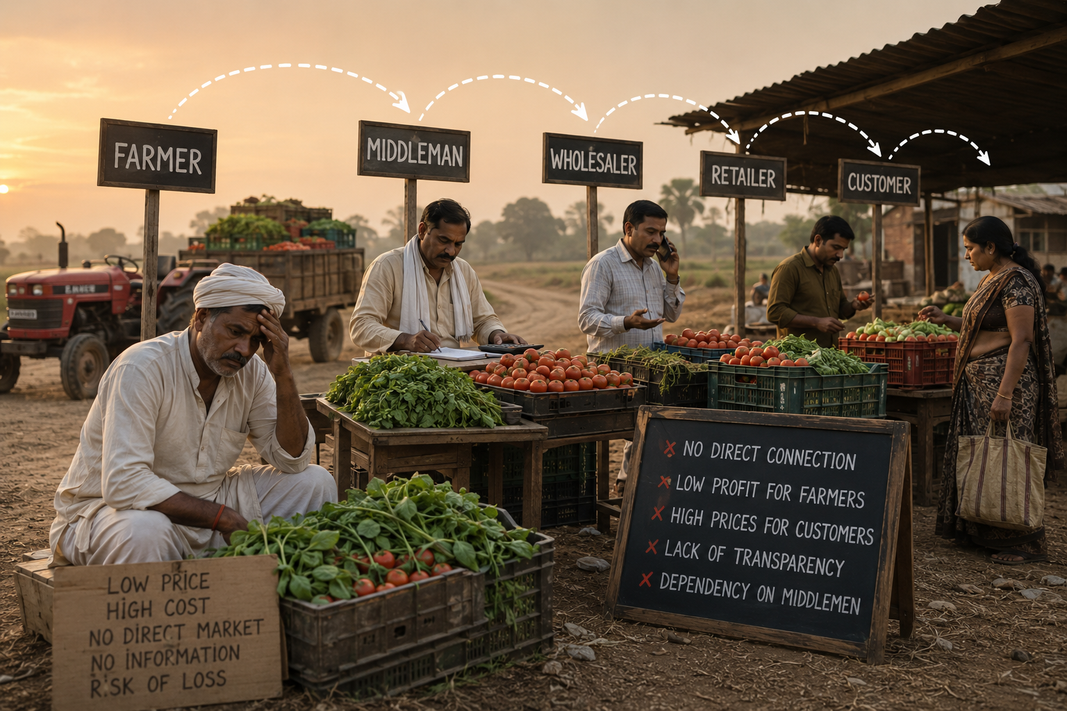
 Existing System
✘ Farmers currently sell their crops in traditional local mandis.
✘ Crops are sold 3 to 4 times between brokers before reaching the buyer, making them costly.
✘ Farmers get no advance payment while growing the crop, forcing them to take loans.
✘ Farmers do not know the actual market prices in the cities.
✘ Farmers write down tasks and money details on paper, which can easily get lost.
[Add diagram showing middleman process]

Slide 6
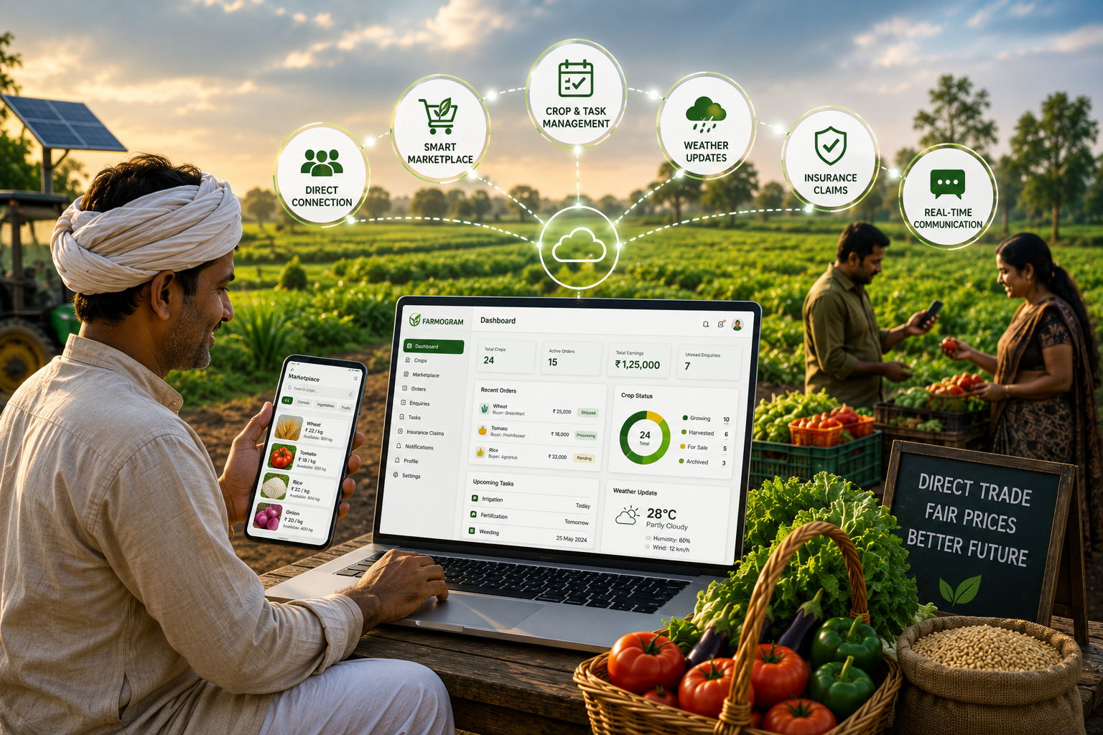
 Proposed System
[Add screenshot of Farmogram home page]
✔ Farmogram provides a direct online market for farmers to sell to buyers without broker fees.
✔ Buyers can pay a 20% advance fee to book crops early.
✔ This advance fee gives farmers the money they need to grow their crops.
✔ The system creates a simple, automatic checklist to help farmers track watering and fertilizing.
✔ Farmers can upload photos of damaged crops to ask for help or insurance easily.

Slide 7
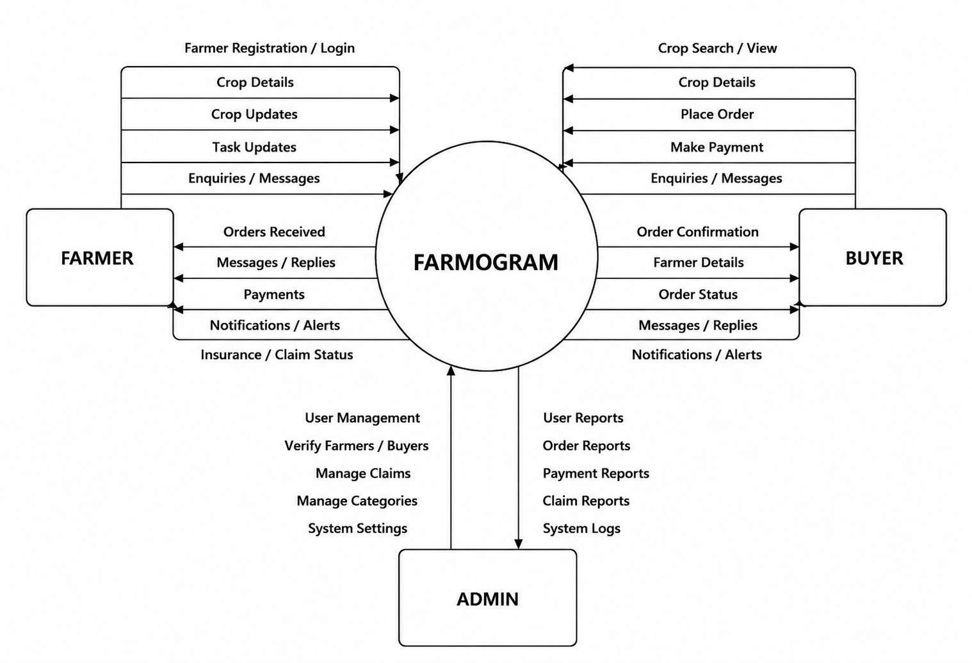
 System Architecture
Data Flow Diagram

Slide 8
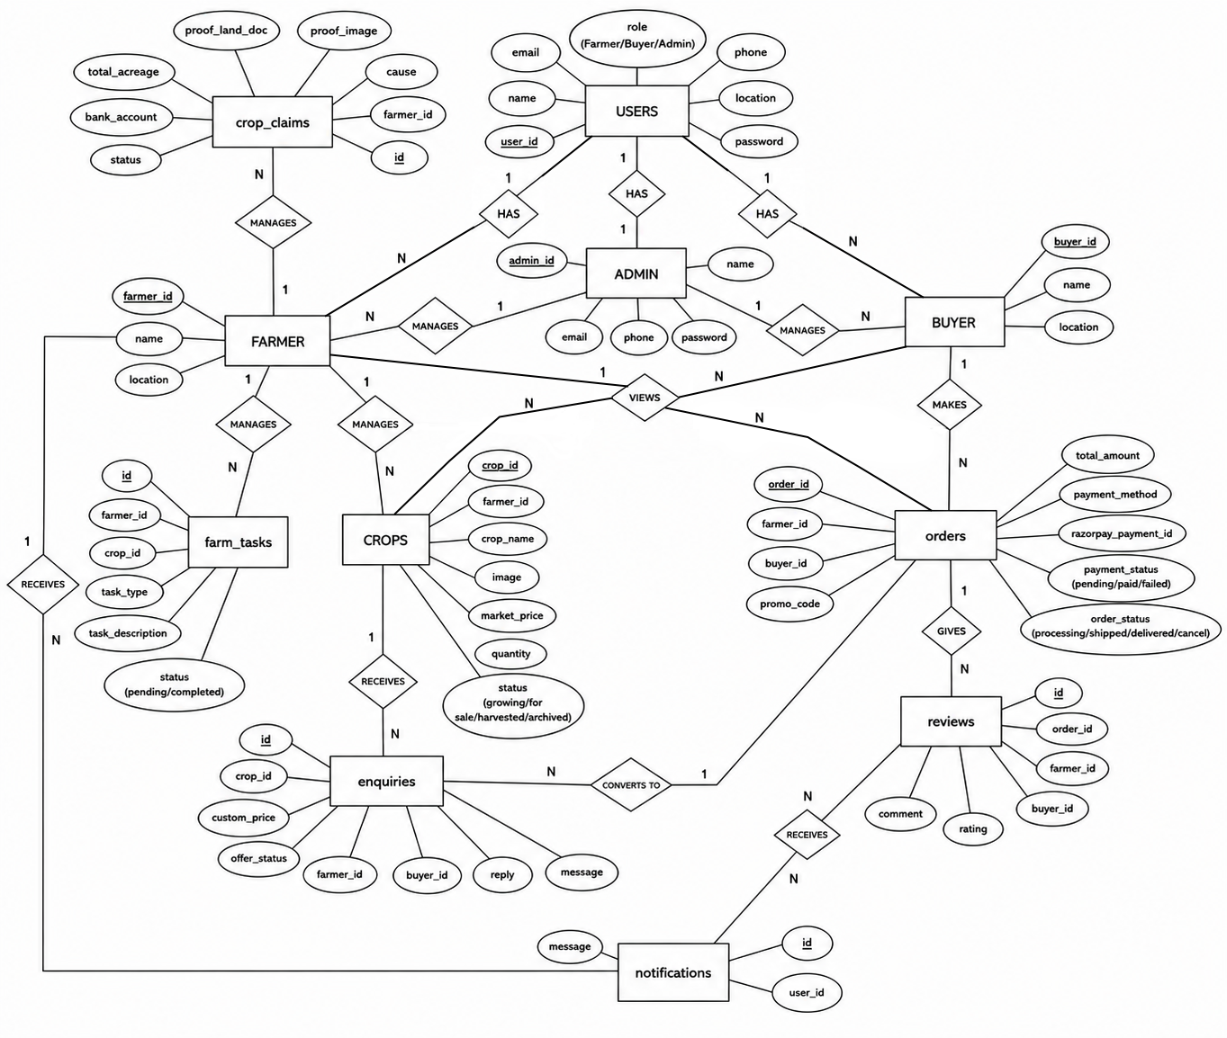
Entity Relationship Diagram

Slide 9
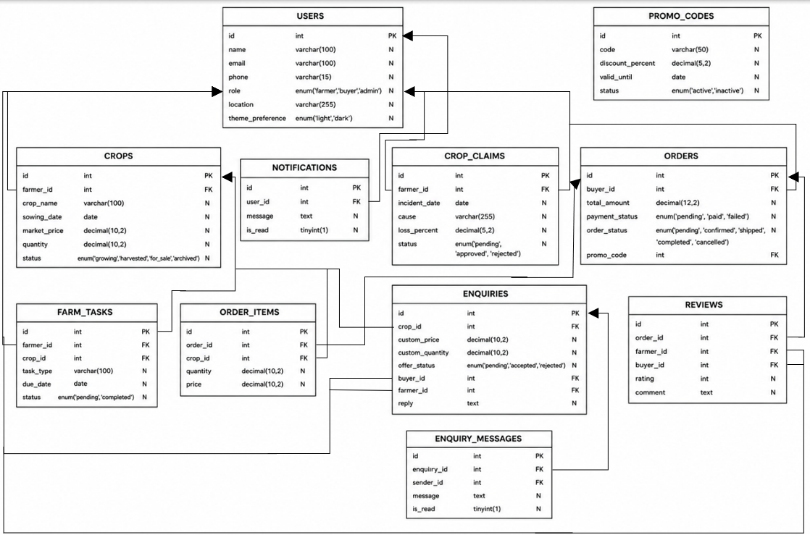
Schema Diagram

Slide 10
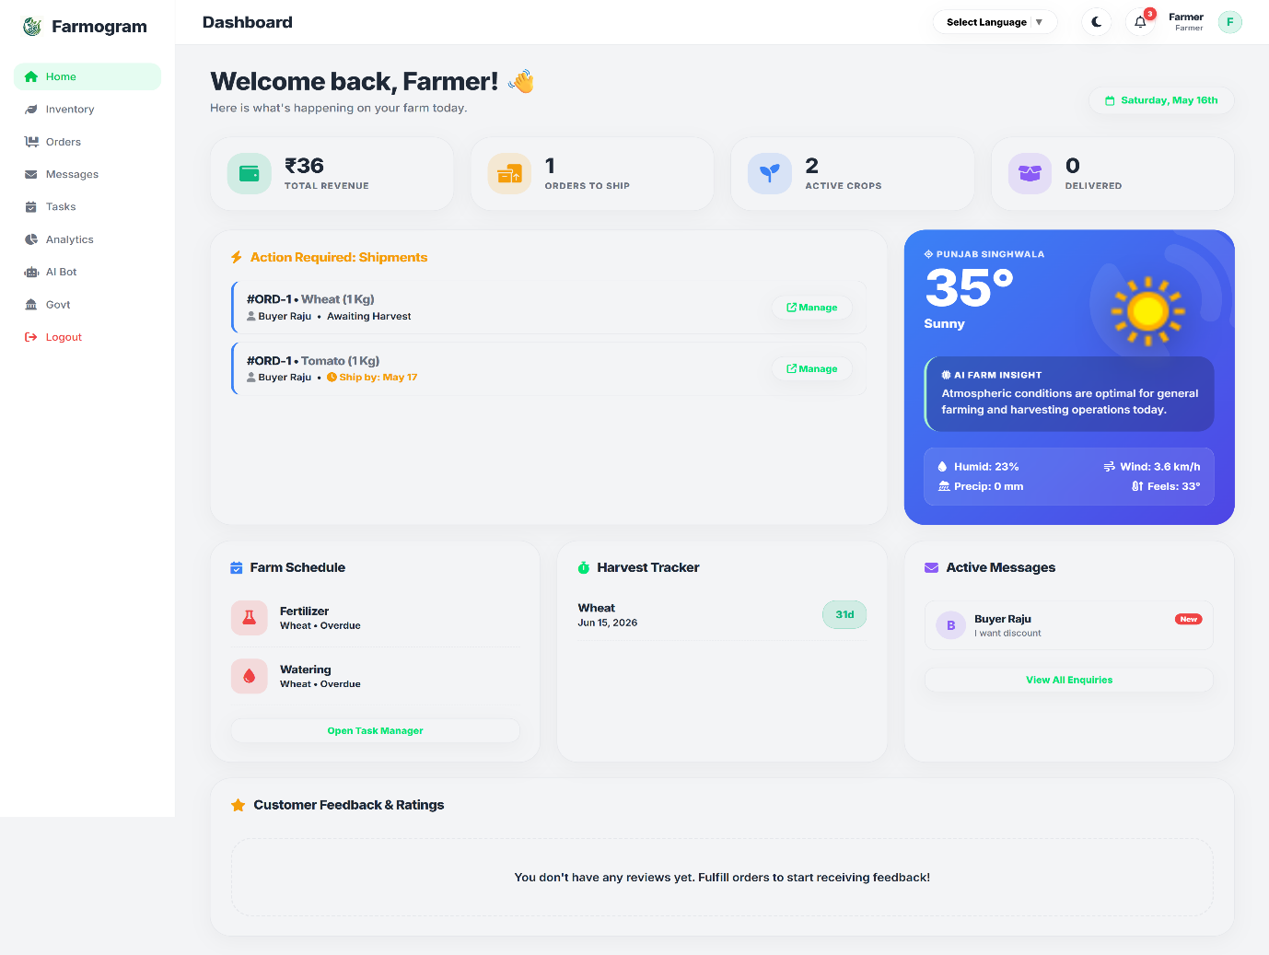
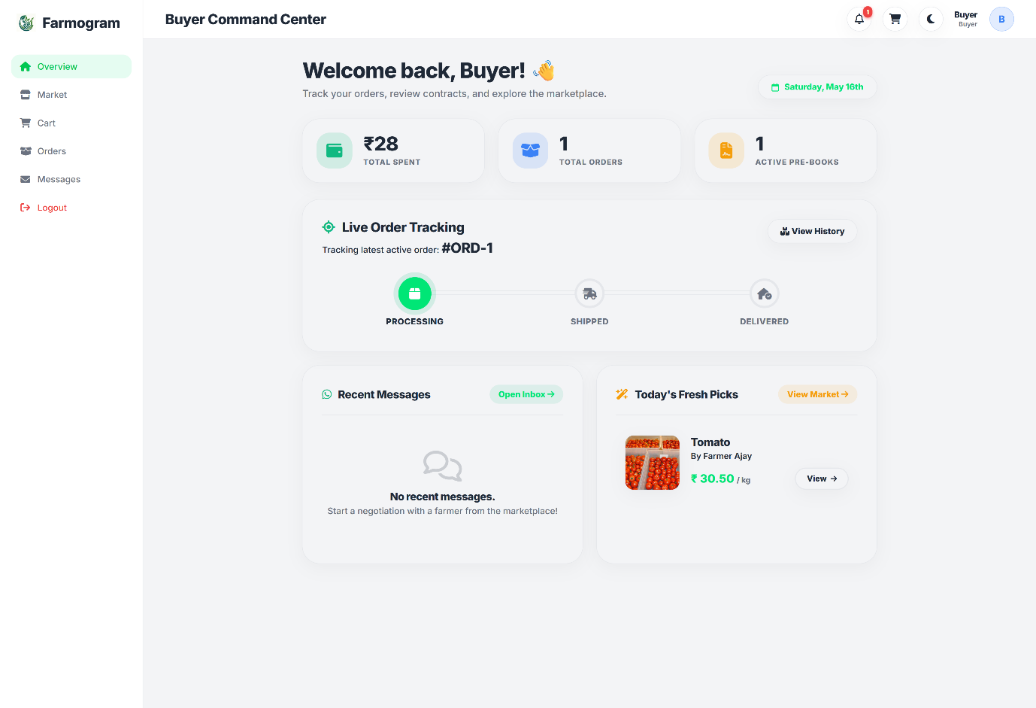
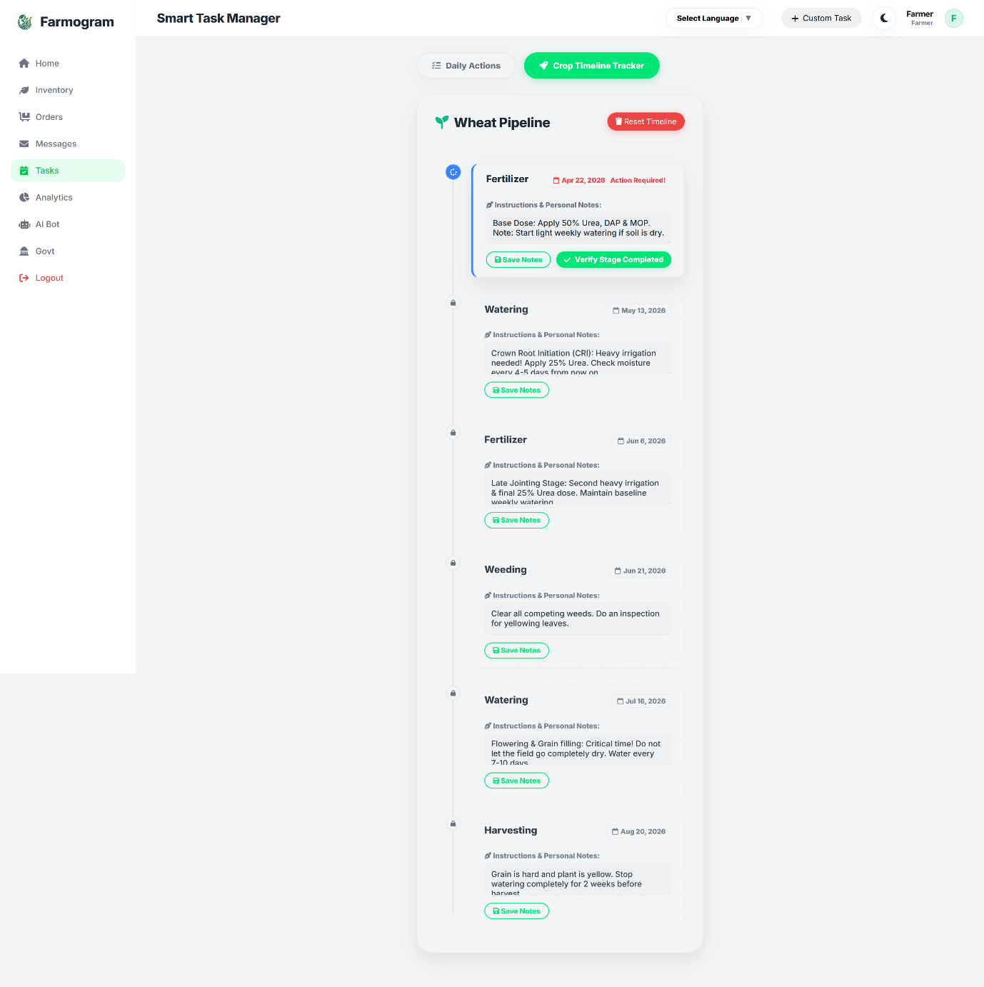
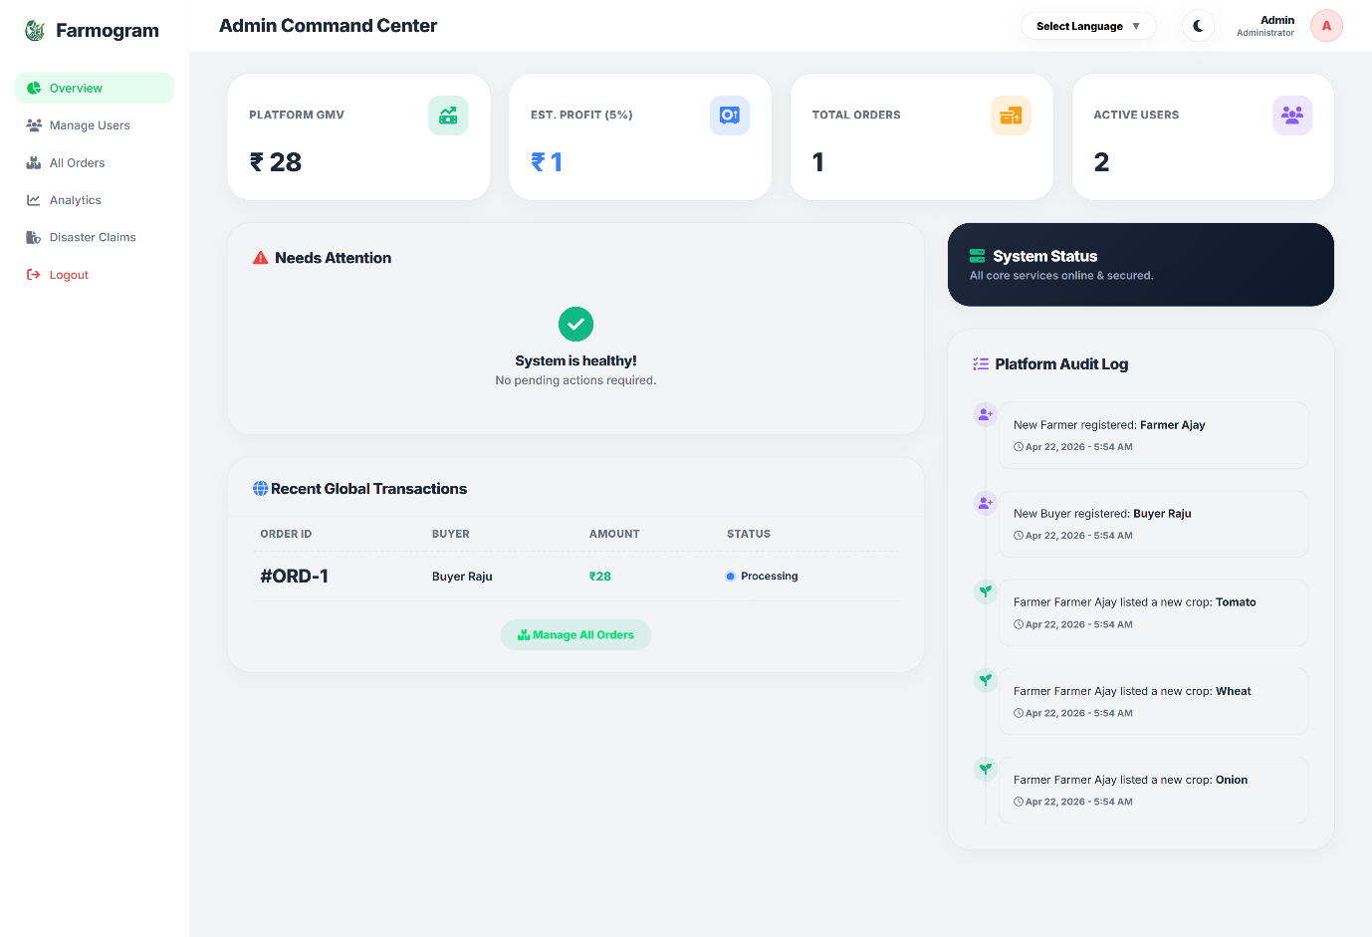
 Implementation & Screenshots

Farmer Screen
The Farmer Dashboard Portal shows daily tasks and money earned.
[Click to add screenshot]

Buyer Screen
The Buyer Marketplace Catalog displays available crops with prices.
[Click to add screenshot]

Task Screen
The Crop Tasks and Farming Calendar tracks when to water and fertilize plants.
[Click to add screenshot]

Admin Screen
The Admin System Overview monitors total sales and system health.
[Click to add screenshot]

Slide 11
 Results & Achievements
✔ The website is fully built and working correctly on a local computer.
✔ Farmers can easily add their crops to the digital marketplace.
✔ Buyers can successfully send price offers and pay the 20% advance amounts.
✔ Daily farming checklists are automatically made for the crops.
✔ The website installs and opens quickly, just like a mobile app.
✔ The database registers pre-booking payments and schedules tasks successfully.

Slide 12
 Advantages

No Broker Fees
Farmers get 100% of the money and increase their income because there are no middle agents.

Advance Booking
The 20% booking money gives farmers early cash to buy seeds without taking loans.

Direct Trust
Direct chat logs and farmer ratings build trust and make buying safe.

Easy Access
Farmers do not need an email; they log in using their phone numbers and local languages.

Slide 13
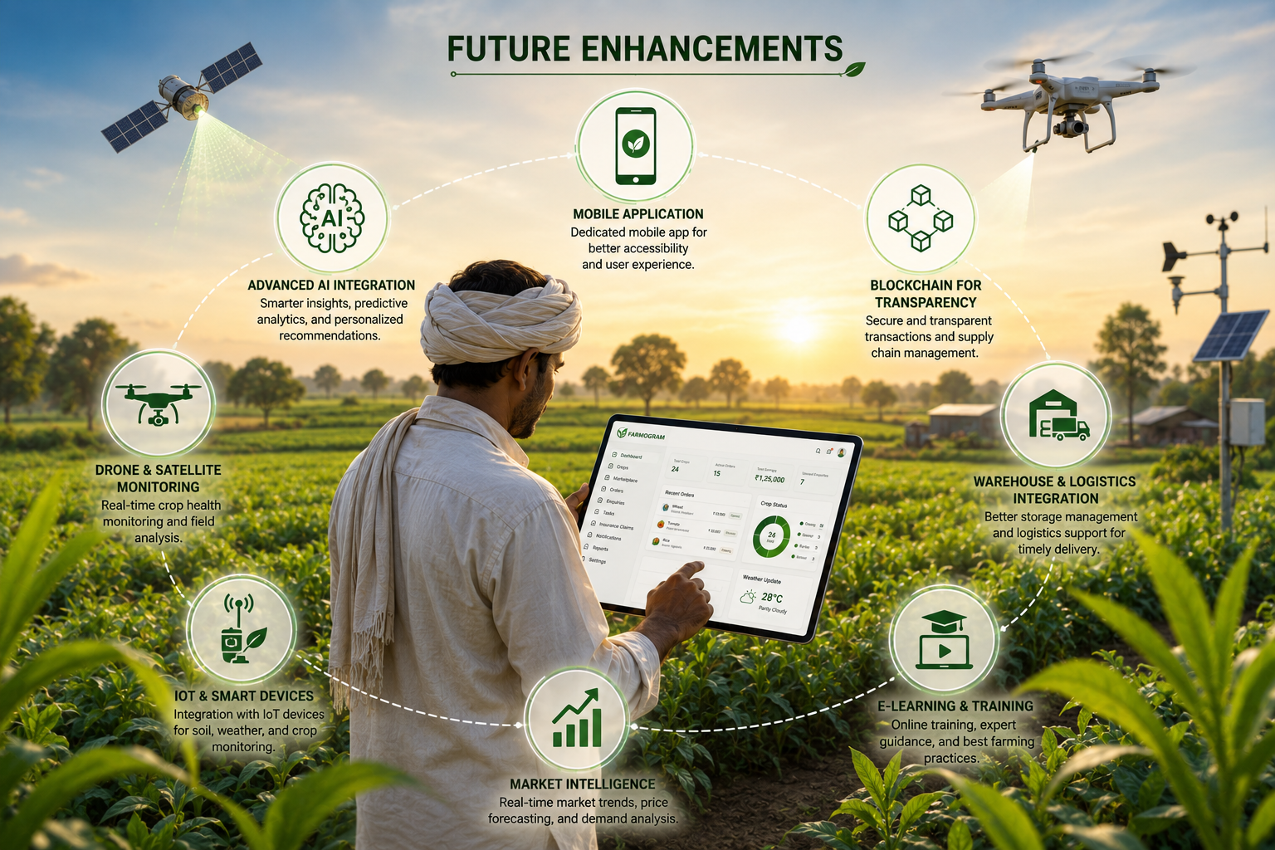
 Future Enhancements
✔ Make the website work offline so farmers can use it without internet.
✔ Let farmers talk to the website using voice controls in their local languages.
✔ Connect with local transport trucks so crops can be shipped directly.
✔ Integrate local bank accounts and digital wallets for quicker payments.
✔ Use AI to scan plant photos and give advice on curing crop diseases.
✔ Build dedicated Android and iOS mobile apps.
[Add Future Roadmap Graphic]

Slide 14
 Conclusion
Farmogram successfully makes crop selling easy and direct.
It solves the high fees of middle agents, the lack of early money, and the language barrier.
It uses direct selling, advance payments, and a crop task calendar to help farmers.
âThe platform creates a fair and modern digital system so farmers can succeed.

Slide 15
 References & Tools
✔ Payments: Razorpay is used for secure online payments.
✔ Data: OpenWeather provides weather forecasting data.
✔ AI Tools: Google Gemini AI powers the smart voice assistant.
✔ Hosting: InfinityFree is used for online web hosting.
✔ Design: Draw.io software was used to draw the system diagrams.
✔ Learning: W3Schools provided online guides for PHP and SQL.
PHP Server
Backend logic and session management.
MySQL Database
Storing user, crop, and order details.



HTML5 Pages
Markup and page structure for PWA.

CSS3 Styling
Responsive layouts and modern typography.

Slide 16
Thank You!
QUESTIONS & ANSWERS
Website: farmogram.gamer.gd
Email: team@farmogram.in
Prajwal Gouda (Reg: U02LT23S0007)
Bachelor of Computer Applications, Himalaya BCA College

